Slide 1
OPT – Optional Practical Training

Slide 2
Optional Practical Training (OPT) is temporary employment authorization that gives F-1 students an opportunity to apply knowledge gained in the classroom to a practical work experience off campus prior to or after graduation.
Most F-1 students who have been in student status for one full academic year are eligible for up to 12 months of OPT. This includes time accrued while maintaining F-1 status at another institution prior to attending Pacific Oaks College, time authorized by a Designated School Official (DSO) to be registered for less than a full course of study during the first year of one’s study, and under other special circumstances.
While a Designated School Official (DSO) recommends OPT in SEVIS, it is the student who must apply for the work permit with the U.S. Citizenship and Immigration Service (USCIS)
OPT is a benefit of the F-1 status that must be requested to USCIS for temporary employment authorization.
If approved, this benefit gives F-1 students an opportunity to apply knowledge gained in the classroom to a practical work experience off campus prior to or after graduation.

Slide 3
TYPES OF OPT
Post-completion
Full-time after the completion of all requirements of
one’s degree. This is the most used form of employment
authorization.
You are generally awarded 12 months total at each academic level for OPT, which must be applied for all at once, you cannot divide this time (for Post-Completion).
Pre-Completion
Part-time when school is in session or full-time during the student’s annual vacation. Pre-Completion OPT is not commonly used as it detracts for Post-OPT.

Slide 4
Who is Eligible
Authorization for Optional Practical Training is granted by the U.S. Citizenship and Immigration Service (USCIS) but requires a Designated School Official (DSO) to make a recommendation for OPT in SEVIS for a student prior to submission of their application to USCIS.
Have been in student status for one full academic year if applying for Pre-Completion OPT
Have maintained F1 status
Must receive recommendations before you can apply for OPT with USCIS
from your academic department and from your Designated School Official
Visit National Center of Mental Health – Aira A.

Slide 5
Step 1: Prepare for OPT Eligibility Review
Get a recommendation letter from your Academic Advisor – determine what your actual Program End Date should be.
Complete the OPT Request Application provided to you by your DSO
Submit the form to your faculty advisor for completion.
Complete a Mock Form I-765, Application for Employment Authorization to prepare for online application. Scroll to the Forms and Document Downloads and select “FormI-765)
Submit everything to your DSO.
DSO will review and communicate with you about any questions and clarifications.
DSO recommends in SEVIS when the recommendation window is open in SEVIS and issue OPT I-20

Slide 6
Step. 2: Prepare Required Documents
You will create an USCIS Account at my.uscis.gov;
You collect all required documents referring to the check list
Make an appointment with your DSO to go through all documents to ensure compliance and you have all required documents legible and ready.
Step. 3: Enter Information on USCIS Account and Upload all Required Documents.
Step 4: Continue to finish the payment process and the rest of the online application and submit.
USCIS will take 3-5 months to review your request. You will receive a receipt simultaneously once you click Submit online and can track the progress in my.uscis.gov. If approved, you will receive an “EAD card” in the mail. Once you have the card in your hand AND the job start date on the card is effective, you may begin work in the field of your study.

Slide 7
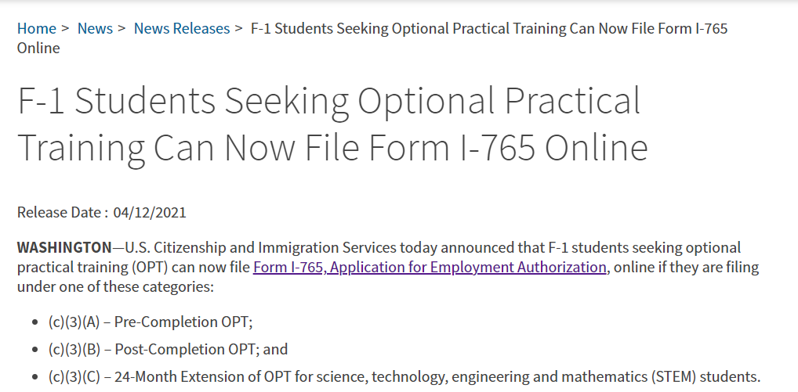
Preparation is the key
Let’s prepare
before you file online!

Slide 8
You Must Create an USCIS Account

Slide 9
Figure out the Dates

Slide 10
Date Selection 1: “Program End Date”
You will meet with your Department Chair/Academic advisor to determine when you will finish your program. It will be the New End Date of your OPT I-20.
It can be:
Earliest - All required course work is completed OR
All required course work & project/thesis/dissertation is completed OR
Latest - All required course work, project, thesis/dissertation, on-campus
employment and any obligations with TCSPP are completed
Your department will then recommend this date in the recommendation letter.
Warning: if you choose the first option, you must be sure that you can finish your thesis/dissertation during your OPT

Slide 11
Date Selection 2: “Application Date”
Your DSO can recommend in SEVIS up to 90 days prior to your actual Program End Date listed on your OPT I-20
No later than 60 days after your actual program end date listed on your I-20
Apply to USCIS, so USCIS can receive your application within 30 days after the date your DSO has signed your I-20 on page 1 and page 2.

Slide 12
Date Selection 3: “OPT Start Date”- a guessing game
Do your best to select the start date of your OPT.
Your 60 day Grace Period after the new Program End Date is the range you can select a start date.
It depends on each individual’s job situation, capability of multitasking, and other factors
If you apply late, picking an earlier start date will not expedite your request. Allow as much time as possible for USCIS to review.

Slide 13
Preparation is the key
Answer Questions on the Form I-765

Slide 14
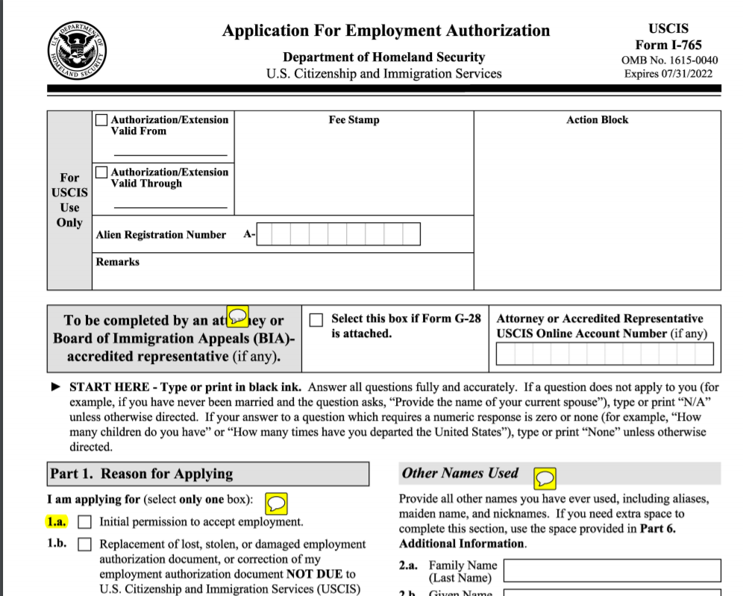
Complete Form I-765 on Paper to Have Answers Ready
Questions on I-765 are transitioned to Online Application Platform
Complete Form I-765 as usual for your DSO’s review
Some tricky questions after revision
Use an Interpreter or No?
Use an Attorney or No?
Physical Address is required and what is the implication?
Parent information is asked if applying SSN at the same time.
When completing I-765, use the Form I-765 Instruction GE puts together for you in addition to USCIS instruction

Slide 15
One more thing:
Do you want to apply SSN when applying for OPT?
Collaborated by USCIS and SSA
You can apply for SSN when you apply for OPT – only time when you do not have a job yet
How?
Check the box for SSA Application
Once you check the box, sub-questions will pop up for you to answer
Keep in mind: if it is approved, you will receive your SSN Card about 2 weeks after you receive your EAD

Slide 16
Collect All Required Documents
and Information

Slide 17
POST- completion OPT Evidence
Evidence | Document to Upload (Save the name as stated below) | Notes
(as listed in online filing system)
2 x 2 photo of you | Passport Photo | See “Photo Requirements” Save as JPEG file
 |  | U.S. Department of State photo requirements.
Form I-94 | Form I-94 | Save as PDF or JPEG Download your most recent I-94 here: https://i94.cbp.dhs.gov/
 | Or
 | Change of Status I-797 Approval
Employment Authorization Document | Passport Bio Page | Save as JPEG Must be clear
 | F-1 Visa
Previously authorized CPT or OPT | I-20(s) with CPT-OPT Authorization | Save as PDF or JPEG Leave empty if no prior OPT or CPT Name accordingly
 | EAD – Previous OPT
Form I-20 for OPT | Form I-20 with OPT Recommendation | Save as PDF Make sure to sign on the first page
Have Everything Ready

Slide 18
Have Everything Ready
Credit Card Info:
Number
Expiration Date
V-Code
Name on Card
Billing Address & zip code

Slide 19
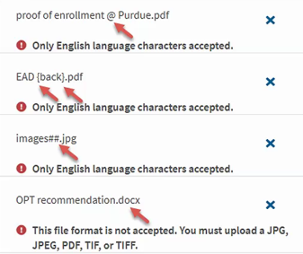
Filling Out the Form – Format
Photos | JPG, JPEG, or PNG
Documents | JPG, JPEG, PDF, TIF or TIFF
Foreign Language | Must have English Translation
Maximum Size | 6 MB per file
Know the Details
The only characters allowed in
document file name:
English letters
Numbers
Spaces
Periods .
Hyphens –
Underscores ___
Parentheses ( )
DO NOT use special characters!

Slide 20
Be Aware of the Restrictions
Reminders before you start:
15 minutes idle – log out
Your entries will be saved for 30 days.
Must edit within 30 days
Once click Continue to pay the fee, your form is submitted and not correction can be made

Slide 21
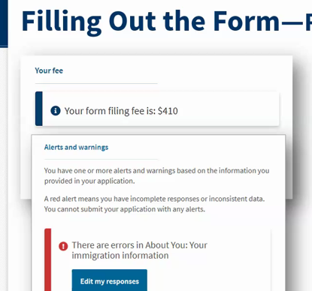
At the End:
Review your entries before you pay
The system will show how much you should pay based on the info you entered
The color code:
Green: the system didn’t find any error or conflict info
Orange: an error is detected but will allow you to file
Red: errors are found, and you are required to correct before moving forward
Listening to kids bout their dreams – Darshita at internship

Slide 22
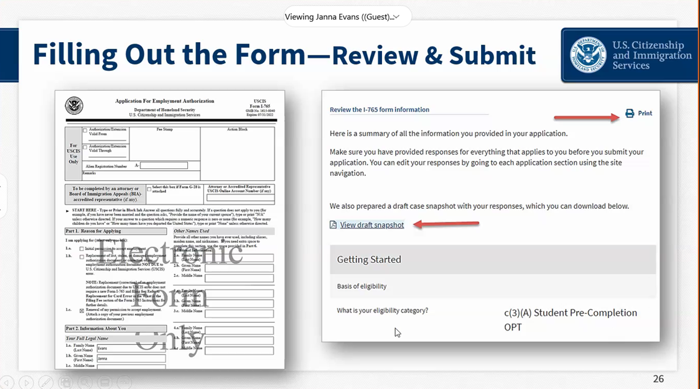
At the End:
Review what you have entered
Make sure you didn’t skip any questions
View Draft Snapshot
Print
Working at practicum (BRAVE Police & Public Safety Wellness Center) – Herold S.

Slide 23
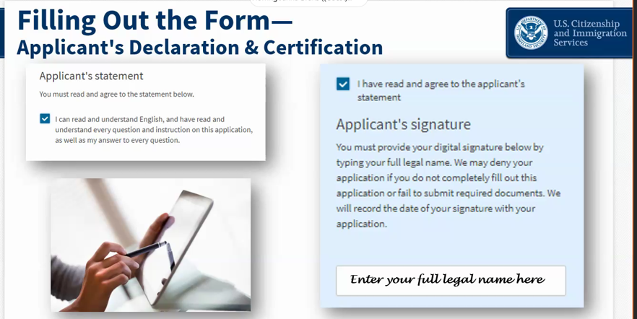
You must read and agree to the statement
Provide your digital signature by typing your full legal name – same as your entered when filling out the online I-765
You will be directed to pay.gov to make a payment
Highly recommend to use credit card
At the End:
STOP: Make an appointment with DSO to review your entries

Slide 24
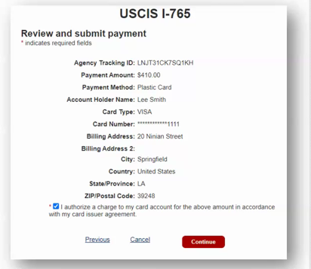
At the End:
Enter payment info as you purchase on other websites
Double check all the digits and billing address information
Note the form type and tracking ID – take a picture for record
When you click “Continue”, your form will be submitted

Slide 25
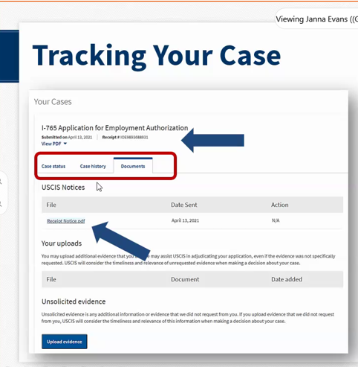
Tracking Your Case
Under the Documents Tab
Receipt Notice
Biometrics notices if applicable
Request for Evidence (RFE)
PDF of completed form
Decision Letter

Slide 26
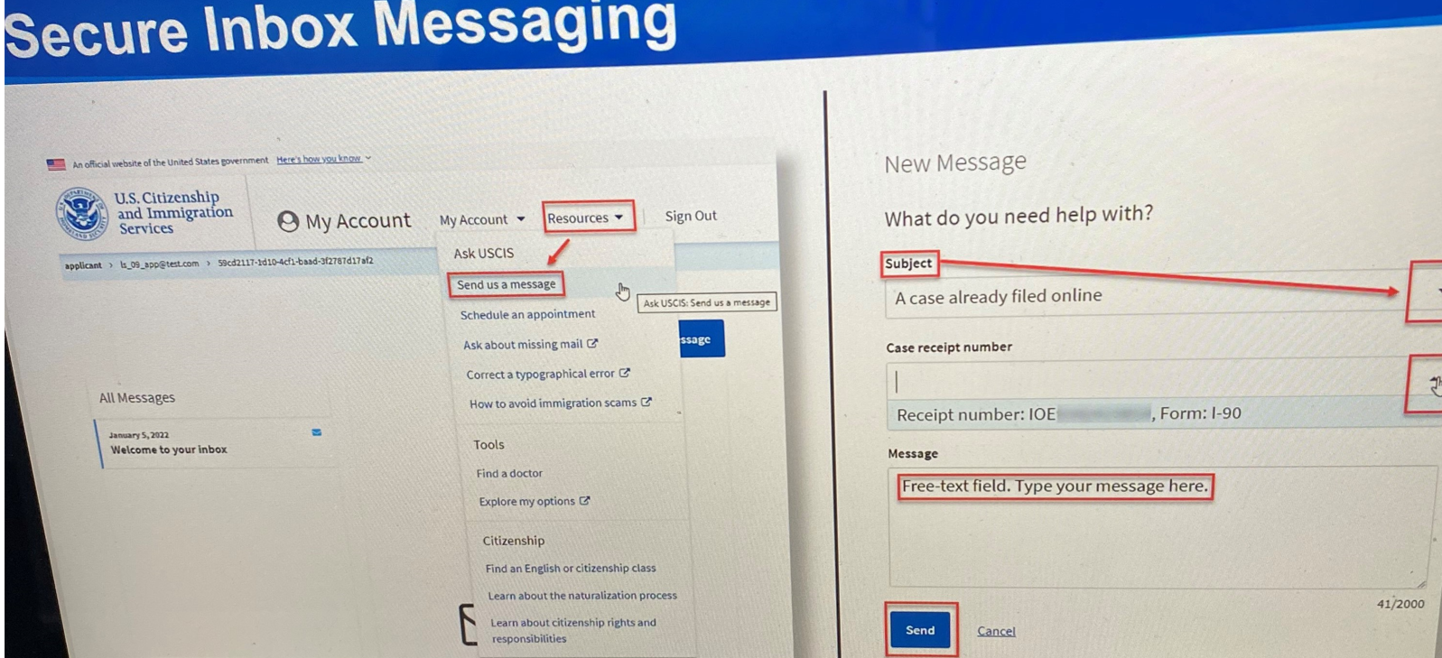
Communication
with USCIS
USCIS Might Call You!
You can email USCIS via your account:
Resources
Send us a message
Response within 72 hours or 30 days if not urgent

Slide 27
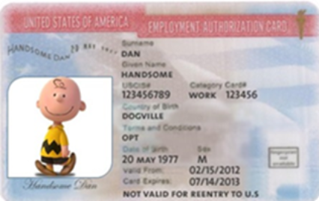
After OPT is Approved:
NOW WHAT?

Slide 28
Steps of Creating SEVP Portal Account
1. SEVP Portal sends email to student
• Email sent from Do-Not-Reply_SEVP@ice.dhs.gov
• Email subject line: Optional Practical Training Approval – the next step.
Create an SEVP Portal account
2. Create an SEVP Portal Account
Email contains a unique link to create an account
Only be used once and cannot be shared
Link will be only active for 14 days
Enter SEVIS ID Number on registration page
Account will lock after three incorrect attempts to enter a SEVIS ID
• Students prompted to create a password
Enter password twice and click “Create Account”
3. Successful Account Creation
• Click Create Account option-Portal will open the login page and
display a success message
SEVIS Portal – Update your OPT

Slide 29
Information for the Portal
What Can You View: Your Bio Information
What Can You Update:
U.S. home and mailing address.
U.S. telephone number.
Foreign telephone number.
Employer name and address – Add and edit employer location,
contact supervisor info and employment dates
Supervisor name and contact information
Employment Change
Do Not Delete Employer if employment changes. Shorten the
end date and enter the new employer
You may trigger the unemployment counter to restart if you do
Enter Explanation of Direct Relationship between Employment and
Program of Study
Fill out the form, so DSO can help complete your SEVIS record

Slide 30
Updates about SEVIS Portal
Now SEVIS Portal will send reminders to your email about
Important deadlines and changes to your SEVIS record
It will send to both your old and new email
Portal Access Expires 6 months after OPT End Date
SEVIS sends two email reminders
5 months prior to the date
30 days prior to the date

Slide 31
You may be approved less than 12 months
Approved more than 12 months doesn’t mean you can work
more than 12 months. Contact your DSO immediately to
request correction from USCIS
The employment start date might be prior to your Program End Date
DO NOT WORK prior to your Program End Date
Talk with DSO to file correction
You may no longer be a student, but you are in F-1 student status,
and all requirements for F1 status still apply.
Travel signature is only valid for 6 months!
If you have not completed your program as anticipated and have
applied or been approved for OPT,
You need to register for classes to maintain your status
Can only work part time
Failure to do so will result in falling out of status. Speak
immediately to your DSO.
Your job must be directly related to the field of your study
Send you DSO the Job Offer Letter and the form shared with you
Update the SEVIS Portal

Slide 32
Unemployment While on OPT
Students may not accrue an aggregate of more than 90 days of unemployment during any post-completion OPT
Unemployment dates will be counted from either the start date of a student’s OPT on the I-20 or the date adjudicated by USCIS on EAD, whichever is later.
Your SEVIS record will be terminated if you have accrued 90 or more days of unemployment and you are required to leave the country immediately after termination

Slide 33
Must be directly related to field of study
Must work at least 20 hours a week and maintain a good record of it
Update position in SEVIS Portal as “Employment”
Cannot start until you receive the EAD card and the OPT start date is effective

Slide 34
Travel and OPT
RED: No Travel – OPT pending adjudication
Yellow: Do not recommend travel – With EAD or a Job Offer
Green: May travel – with EAD and a Job Offer
However, keep in mind that there is always a risk when travel abroad after the purpose of the original visa status has been completed.

Slide 35
Transfer and OPT
Your OPT ends on the date you select to transfer your record out of your current school.
Any unused OPT will be forfeited.

Slide 36
Direct Relationship between
OPT Employment and Field of Study
NEW GUIDELINES
Must directly related to your field of study
Must provide an Explanation of Direct Relationship
to your DSO after a job offer is received
Must provide your DSO a Job Offer Letter for review
Must update your account in SEVIS Portal to explain
Must provide new Explanation
if employment is changed
if obtain an additional employment

