Slide 1
2023
63rd Annual
Commencement ceremony

Slide 2
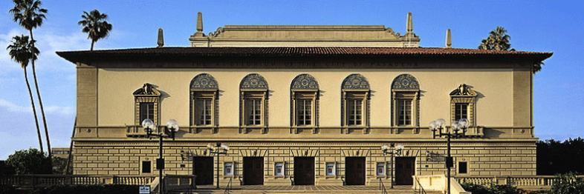
Pasadena Civic Auditorium
300 E Green St, Pasadena, CA 91101
Saturday, July 15, 2023 • 10:00 a.m.- 12:00 p.m.
Graduate Check-in opens at 8:30 a.m. (Exhibit Hall C, behind the Auditorium)
Auditorium Doors Open for Guest: 9:00 a.m.

Slide 3
IMPORTANT REMINDERS FOR GRADUATES
Graduate Check-in: Located in the Exhibit Hall C behind the Civic Auditorium. Opens at 8:30 a.m. (see map).
**Graduates are to arrive on-time. Graduates must arrive no later than 9:00 a.m. Coffee, tea, and water will be available for the graduates only.
Entrance for Guests: Doors open at 9:00 a.m. in front of the Pasadena Civic Auditorium (General seating only, first come, first serve)
Ceremony Tickets: An electronic ticket is REQUIRED for all guests entering the auditorium. (Graduates do not require a ticket)
Information for Guests: No balloons. No noise makers or air horns. No video recording, but pictures are okay.
Professional graduate picture (on stage): A link will added to the commencement page for future purchases.
Parking: Parking is available at the Paseo Colorado Parking Garage located across from the Civic Center or all other surrounding parking garages. Graduates and guests are responsible for any parking fees or charges. Parking fees may vary.
Handicap Seating: Seating will be available for guests in the back of the auditorium. (first come, first serve)
Dress Attire: Please come dressed and ready with your CAP, GOWN, TASSEL, Hood (Master’s students only). There is no place to change clothes. Wear comfortable shoes. No heels
Belongings: Please do not bring any additional belongings with you. You will not be allowed to walk on stage with them. We recommend you leave them with family members. There is no place to leave them behind. No exceptions.
Cap Decorations: Yes! You can decorate your caps.
Alumni Gift: Will be provided to you when you check in.
HOODINGS: Please contact the Academic Departments for more information. (Contact information listed on the commencement webpage)

Slide 4
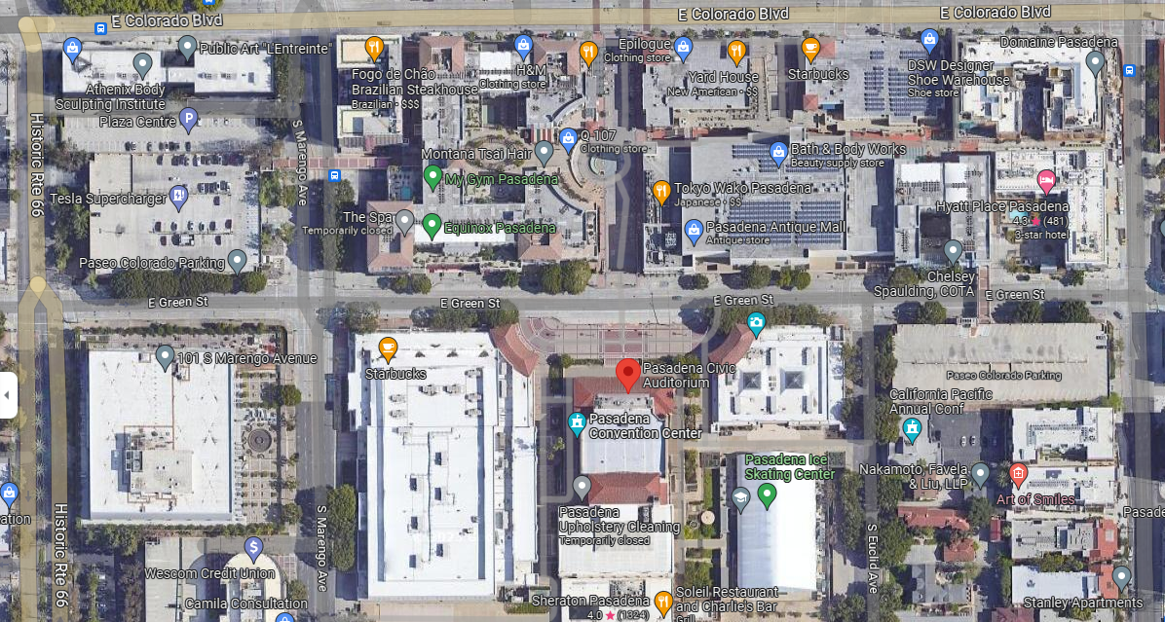
Parking for graduates and guest
Available across the street at Paseo or surrounding parking garages
(Graduates and guest are responsible for their own parking fees. Fees may vary)
Parking
Parking
Parking
Pasadena Civic
Auditorium
Exhibit
Hall C

Slide 5
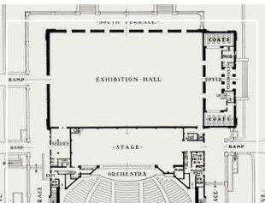


Graduate Check-In: Exhibit Hall C
Graduates will be directed to Exhibit Hall C behind the Auditorium. There will be stanchions set-up and door monitors assigned. You will enter the exhibit hall from the exterior of the building.
Exhibit Hall C
Graduate Line up
X
X
X
X
X
X
X

Slide 6
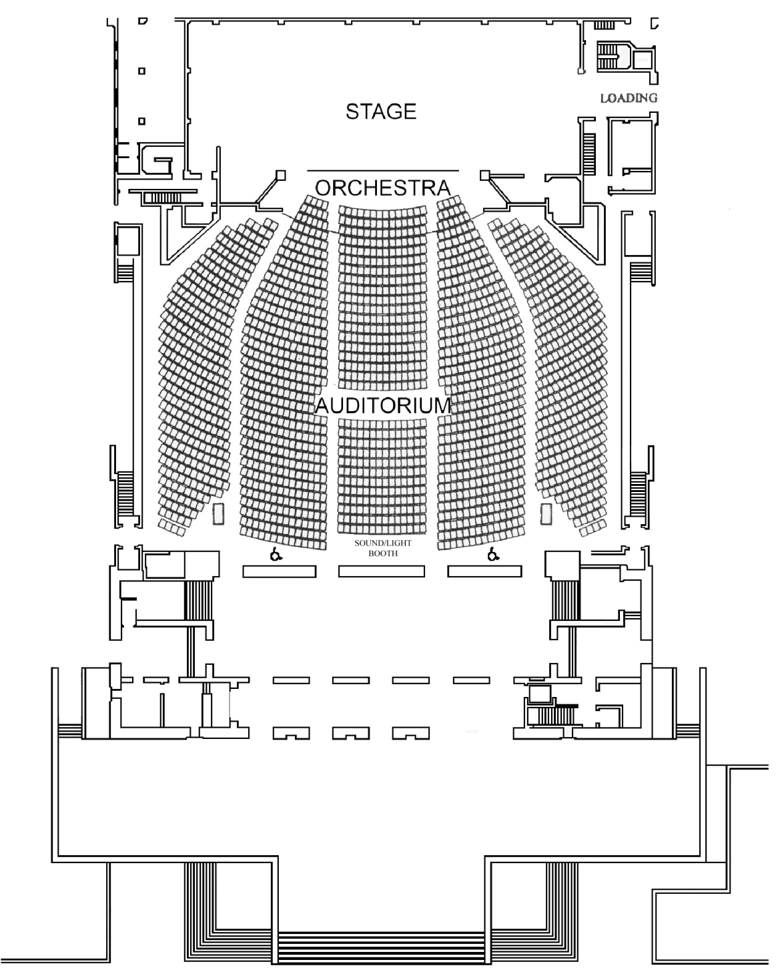
Graduate Seating
Area
Graduate
Seating
area
only
Graduates will sit in the center area only. You will be seated with your program.

Slide 7
CONGRATULATIONS
GRADUATES!
For more information, please email us at poccommencement@pacificoaks.edu

